Slide 1
Latent Dirichlet Allocation (LDA)
- for ML-IR Discussion Group
Prepared by Wayne Tai Lee, Satpreet Singh

Slide 2
Latent Dirichlet Allocation:
A Bayesian Unsupervised Learning Model
Roadmap
Unsupervised learning
Bayesian Statistics
Mixture Models
LDA – theory and intuition
LDA – practice and applications

Slide 3
Unsupervised Learning
Learning patterns with no labels
Clustering is a form of “Unsupervised learning”
  Classification is known as supervised learning
Validation is difficult

Slide 4
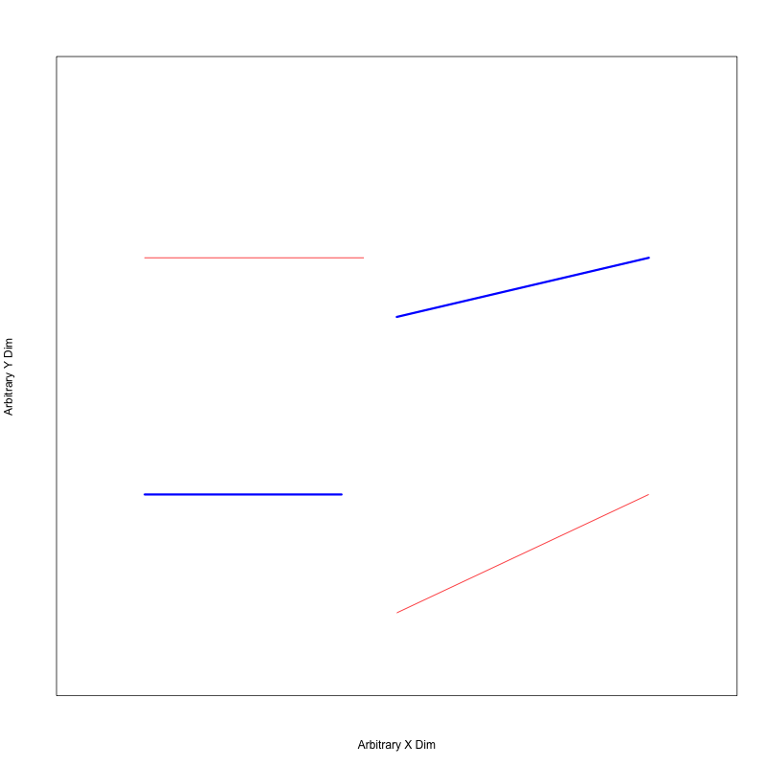
How would you cluster?
Notes:
Take home: validation is difficult….no true answer here.

Slide 5
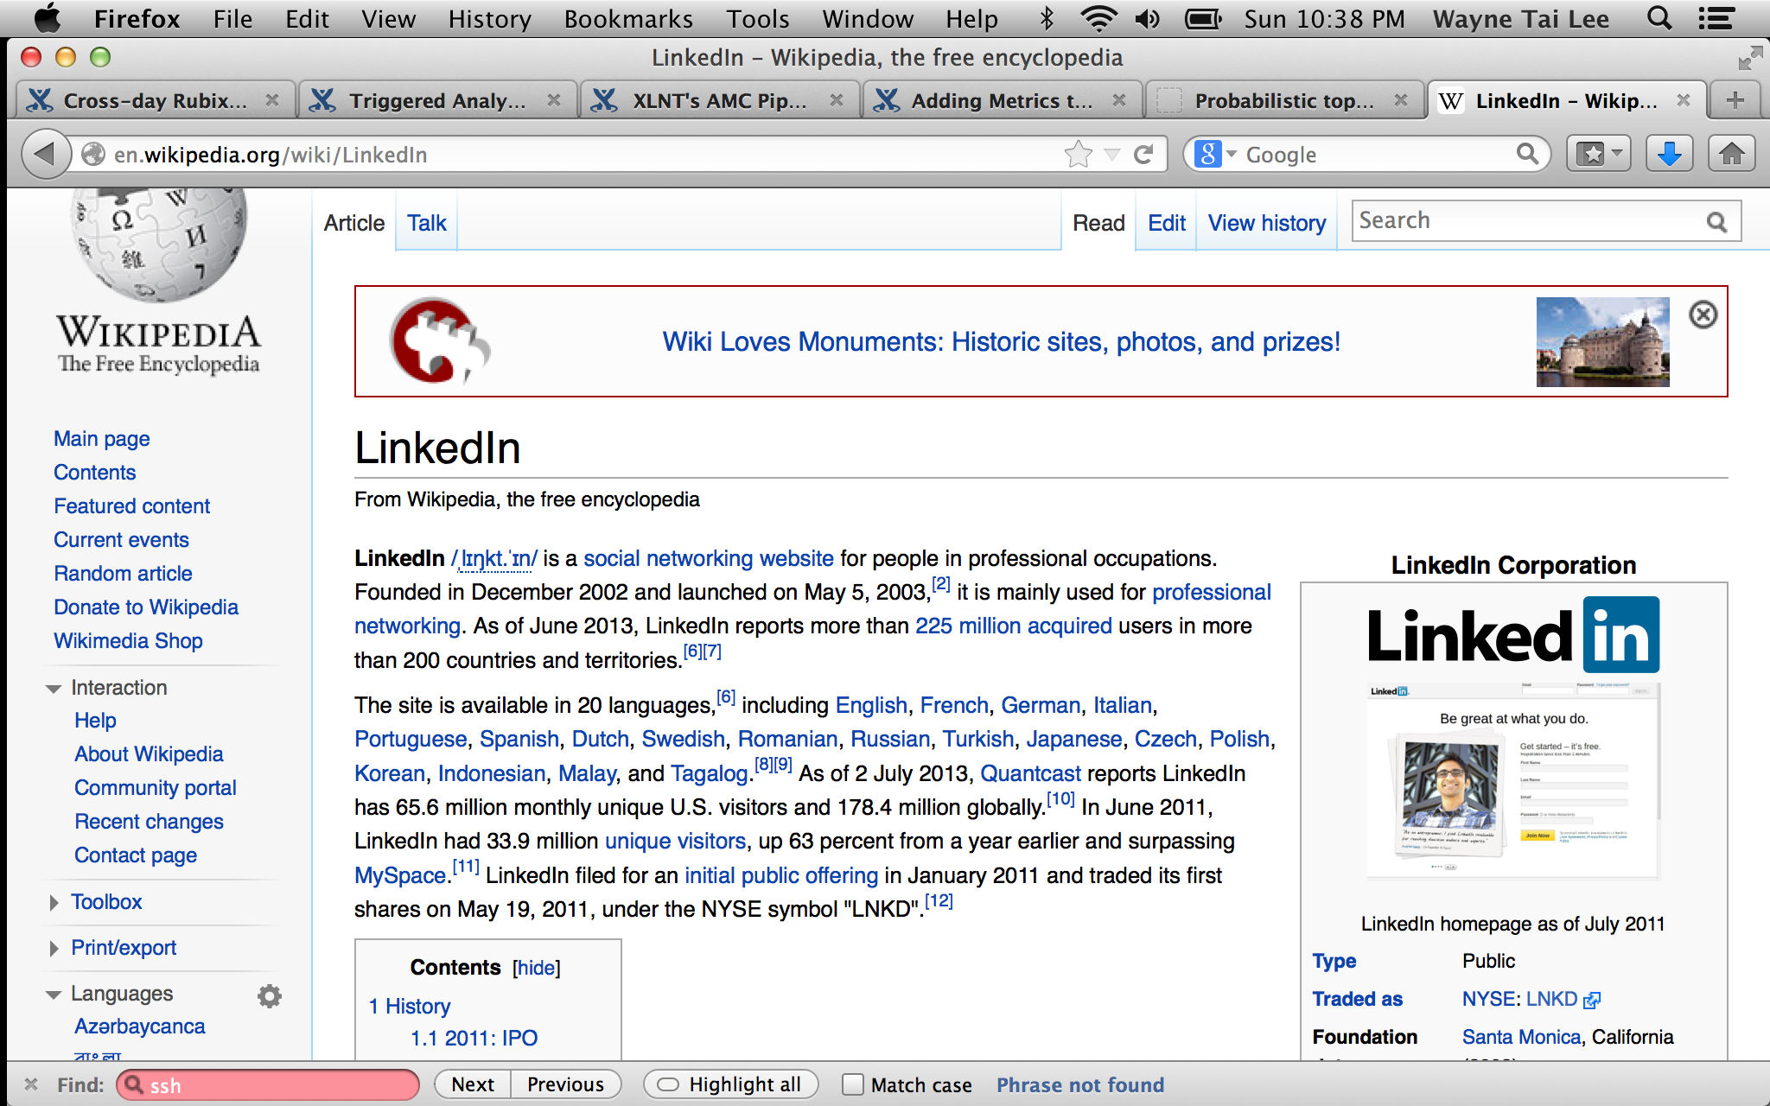
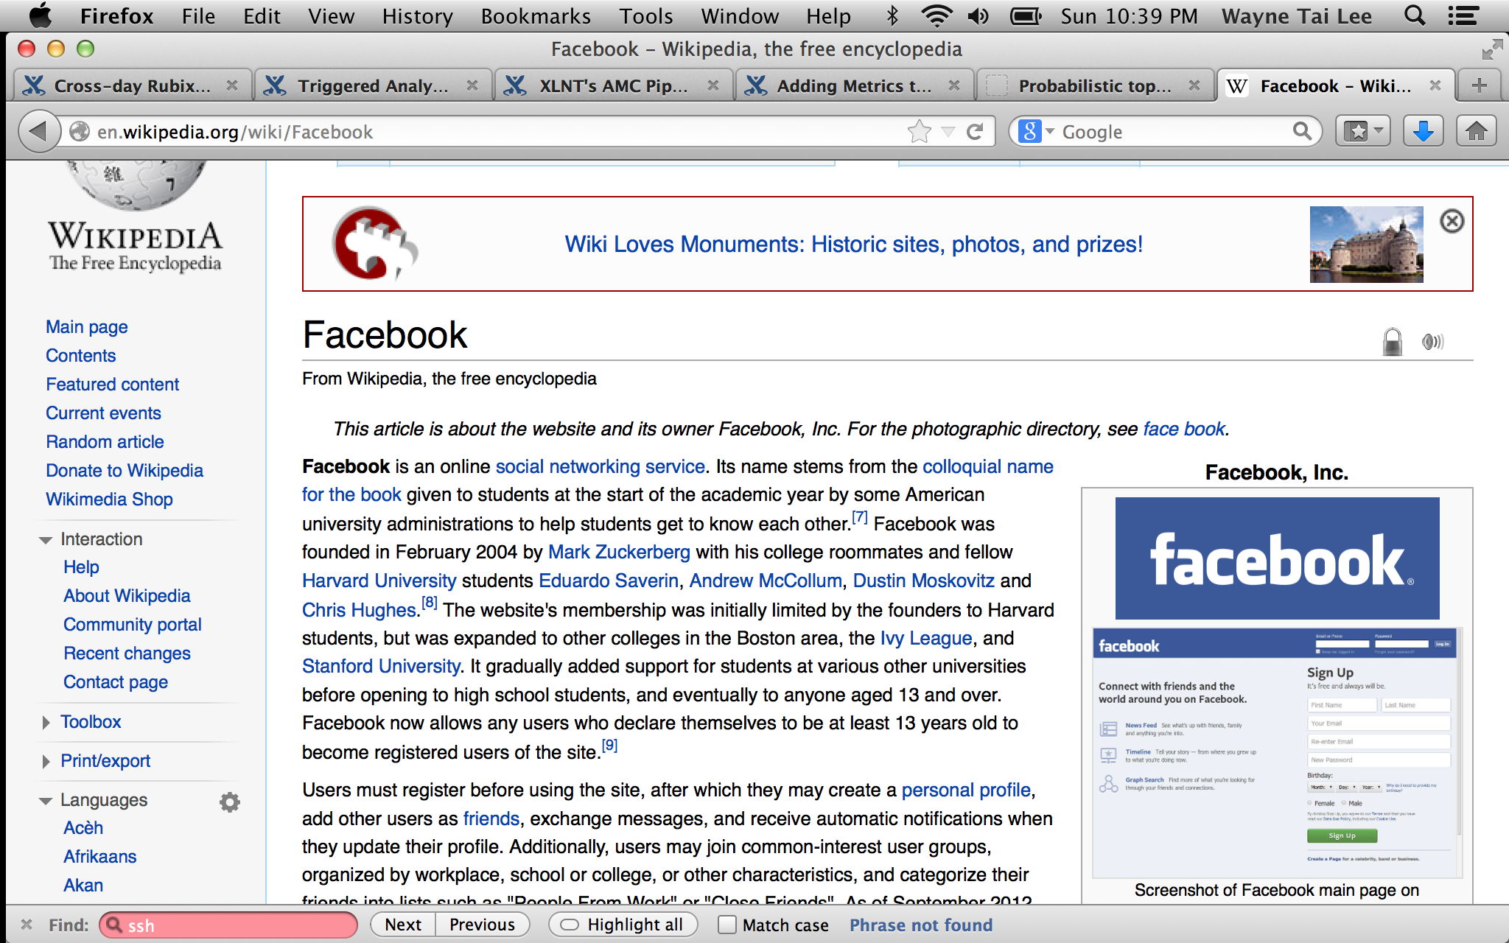
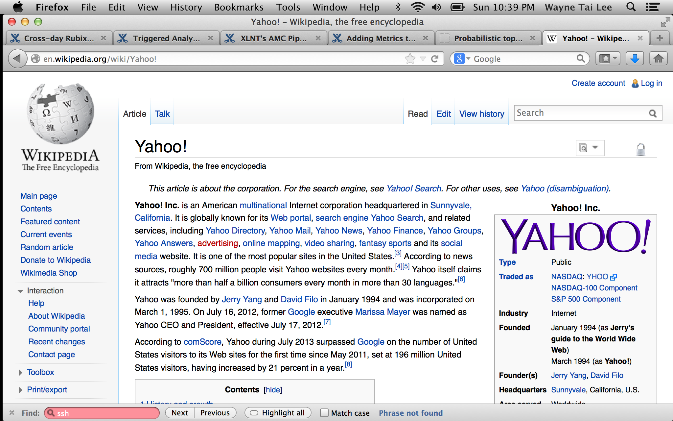
Now try these ones!
Documents of wikipedia
Notes:
Clustering documents is difficult because many repeated words are used. Some documents may be similar to one another on different topics. So we might want to cluster allowing membership.

Slide 6
Bayesian Statistics
A framework to update your beliefs
Probabilities as beliefs
Updates your belief as data is observed
Requires a model that describes the data generation

Slide 7
Example: Evaluating Candidates
Candidate potential

Slide 8
Example: Evaluating Candidates
Schooling
Internship
Candidate potential
Interview
Experience

Slide 9
Example: Evaluating Candidates
Schooling
Internship
Candidate potential
Interview
Experience
How to update?!

Slide 10
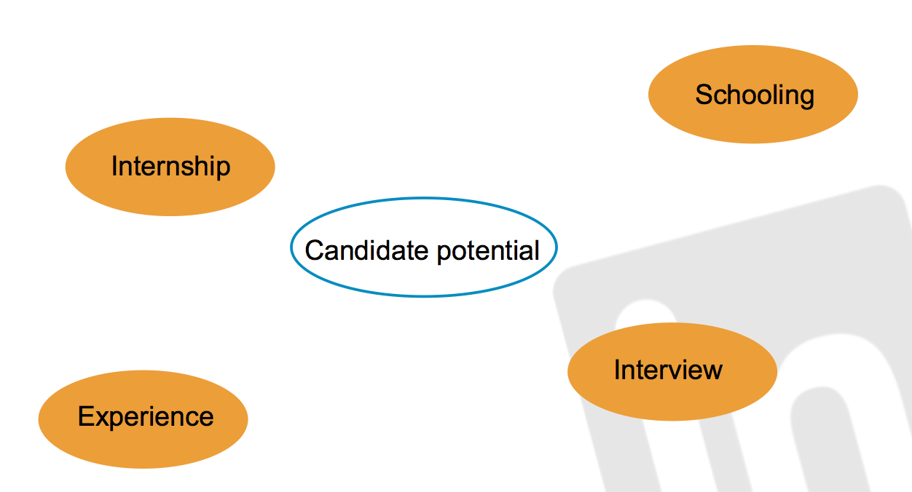


Slide 11
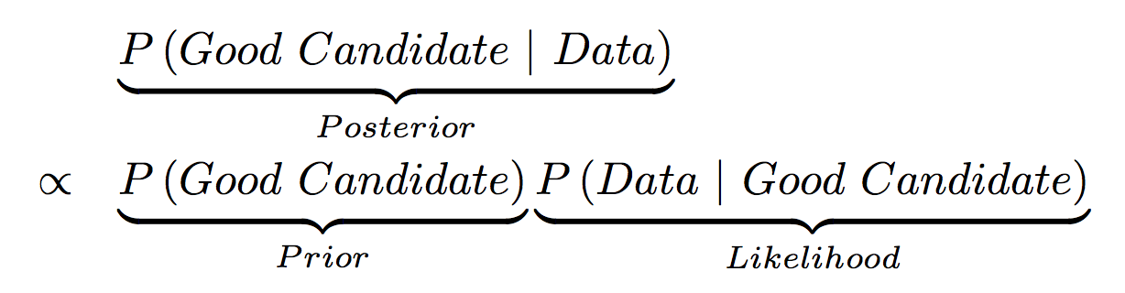
Model for candidates
Model for data generation

Slide 12
Mixture Models
A popular statistical model
An easy way to build hierarchical relationships

Slide 13
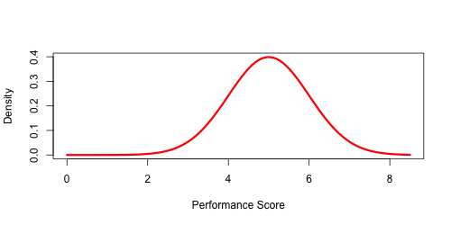
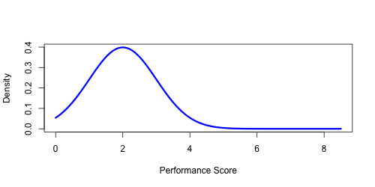
Mixture models visualized
High
Candidate Quality
Low
Notes:
2 stage process

Slide 14
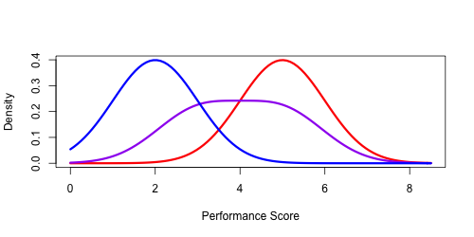
Marginal Distribution of Candidate Performance: ignore quality

Slide 15
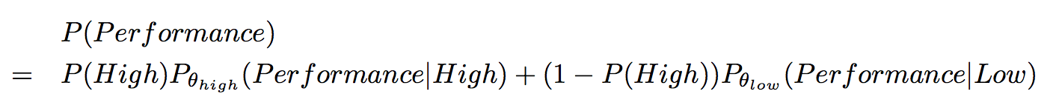
Distribution of Candidate Performance:

Slide 16
Distribution of Candidate Performance:
Mixture Weights

Slide 17
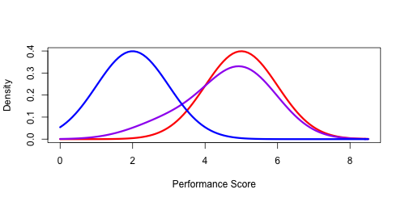
Distribution of Candidate Performance:
Mixture Weights

Slide 18
Distribution of Candidate Performance:
?
?
?
?

Slide 19
How are words in a document generated?

Slide 20
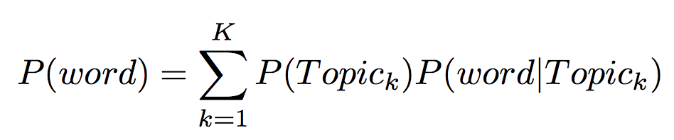
One possibility:
Each word comes from different topics (bag of words: ignore order)

Slide 21
How are words in a document generated?
Each word comes from different topics
Mixture Weight
for Topic k
Multinomial Distribution
over ALL words based
on topic k
Notes:
Example: the word usage of “professional” is probably higher in the topic of professional network than a social network.

Slide 22
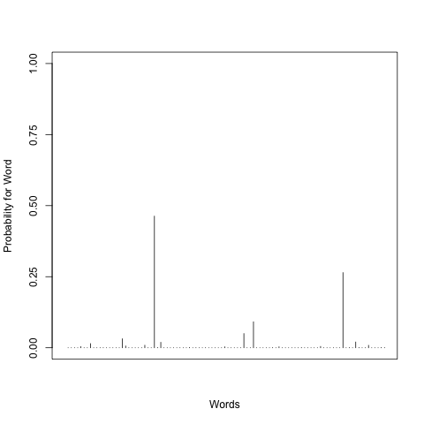
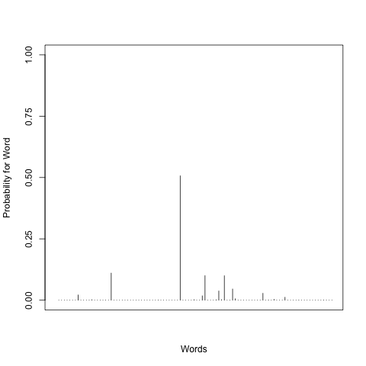
Just a mixture model
Big Data
Machine Learning
Topic 1
Word
Leadership
Topic K
Notes:
2 stage process

Slide 23
Just a mixture model
2) Pick a word
Big Data
1) Pick a topic
Machine Learning
Topic 1
Word
Leadership
Topic K
Notes:
2 stage process

Slide 24


Just a mixture model
Big Data
Machine Learning
Topic 1
Word
Leadership
Topic K
The chosen
Topic: Z
Notes:
2 stage process

Slide 25


Just a mixture model
So we really want to know
Z
_
_
Big Data
Machine Learning
Topic 1
Word
Leadership
Topic K
The chosen
Topic: Z
Notes:
2 stage process

Slide 26
Just a mixture model
So we really want to know
Z (cluster for the word)
(document composition)
(key words)
Big Data
Machine Learning
Topic 1
Word
Leadership
Topic K
The chosen
Topic: Z
Notes:
2 stage process

Slide 27
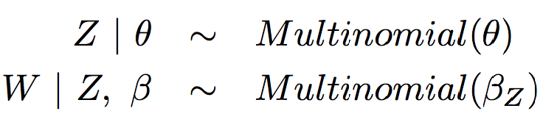
Review!
Z
W
Notes:
Example: the word usage of “professional” is probably higher in the topic of professional network than a social network.

Slide 28
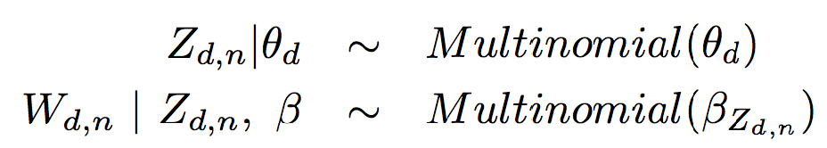


K: number of topics
N_{d}: number of words
D: number of documents
Z_{d,n}
W_{d,n}
n=1,…,N_{d}
k=1…K
d=1,…,D
Notes:
Example: the word usage of “professional” is probably higher in the topic of professional network than a social network.

Slide 29
K: number of topics
N_{d}: number of words
D: number of documents
Bayesian: But what about the distribution for and ??
Z_{d,n}
W_{d,n}
n=1,…,N_{d}
k=1…K
d=1,…,D
Notes:
Example: the word usage of “professional” is probably higher in the topic of professional network than a social network.

Slide 30
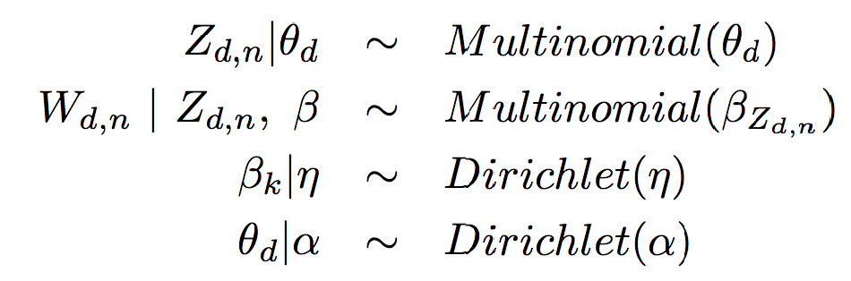


K: number of topics
N_{d}: number of words
D: number of documents
Bayesian: But what about the distribution for and ??
Z_{d,n}
W_{d,n}
n=1,…,N_{d}
k=1…K
d=1,…,D
Notes:
Example: the word usage of “professional” is probably higher in the topic of professional network than a social network.

Slide 31
and control the “sparsity” of the weights for the multinomial.
Implications: a priori we assume
Topics have few key words
Documents only have a small subset of topics
Notes:
Example: the word usage of “professional” is probably higher in the topic of professional network than a social network.

Slide 32
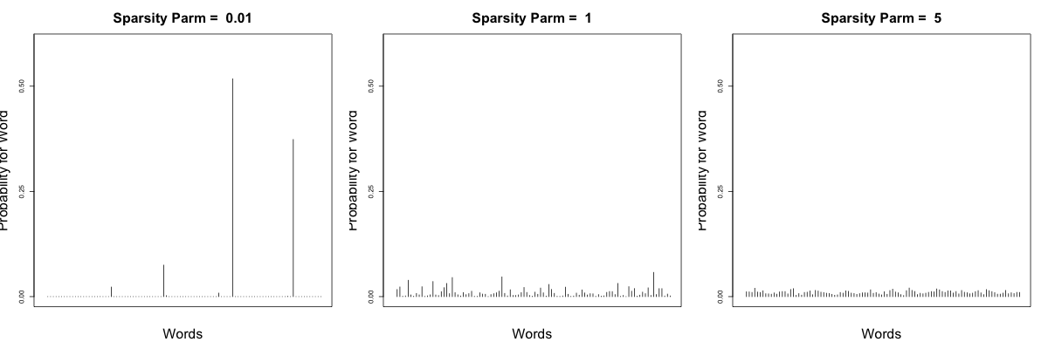
Dirichlet Distribution with Different Sparsity Parameters

Slide 33
Latent Dirichlet Allocation!!!
Z_{d,n}
W_{d,n}
n=1,…,N_{d}
k=1…K
Notes:
Example: the word usage of “professional” is probably higher in the topic of professional network than a social network.

Slide 34
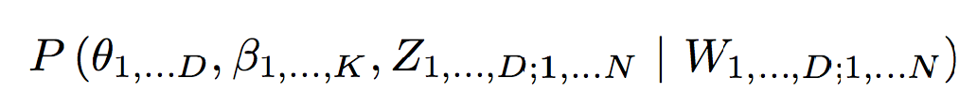
How do we fit this model?
Want the posterior:
Worst part of Bayesian Analysis…..personally speaking~
Notes:
Example: the word usage of “professional” is probably higher in the topic of professional network than a social network.

Slide 35
Two main ways to get posterior:
Sampling methods
  Asymtotically correct
  Time consuming
  Lots of black magic in sampling tricks
Variational methods (practical solution!)
  An approximation with no guarantees
  Faster
  Need math skills
Notes:
Example: the word usage of “professional” is probably higher in the topic of professional network than a social network.

Slide 36
Variational Bayes (specifically mean field variational bayes):
What’s crazy?
Assumes all the latent variables are independent
What’s not crazy?
Finds the “best” model within this crazy class.
  Best under KL divergence
Empirically have shown promising results!
For “sufficient” details:
“Explaining Variational Approximations ” by Ormerod and Wand
Notes:
Example: the word usage of “professional” is probably higher in the topic of professional network than a social network.

Slide 37
LDA Take Home
An intuitively appealing Bayesian unsupervised learning model
Training is difficult
  Lots of packages exist, main issue is scalability
Validation is difficult
  Usually cast into a supervised learning framework
Presentation is difficult
  Visualization for the Bayesian model is hard.

